Slide 1

Hadoop 101: Запусти слона
Yaroslav Yermilov
Senior Software Engineer, EPAM Systems

Slide 2
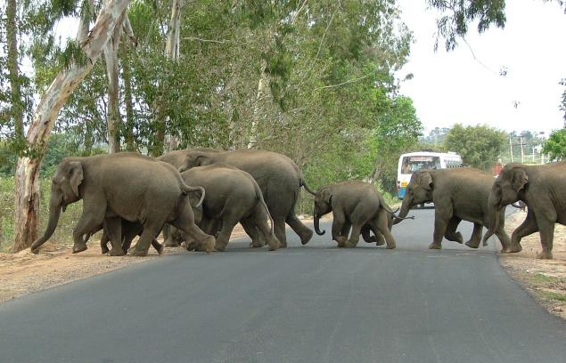
we have lots of data

Slide 3

it will be great to use it somehow

Slide 4
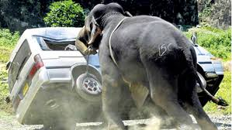
but it’s really hard

Slide 5
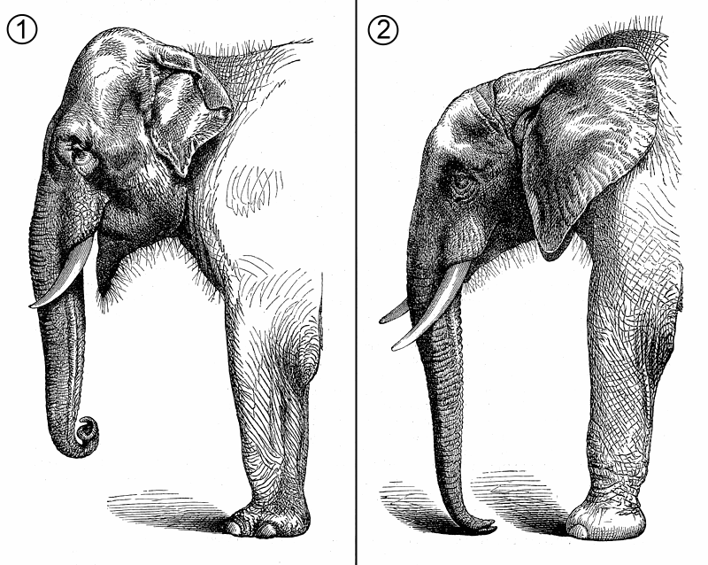
RDBMS
Grid computing
Volunteer computing
Apache Hadoop

Slide 6
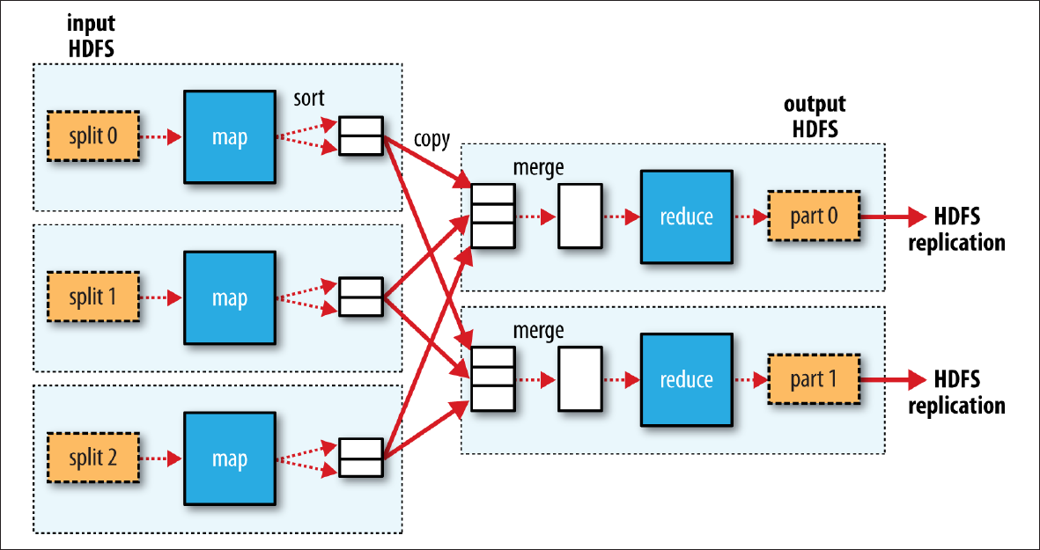
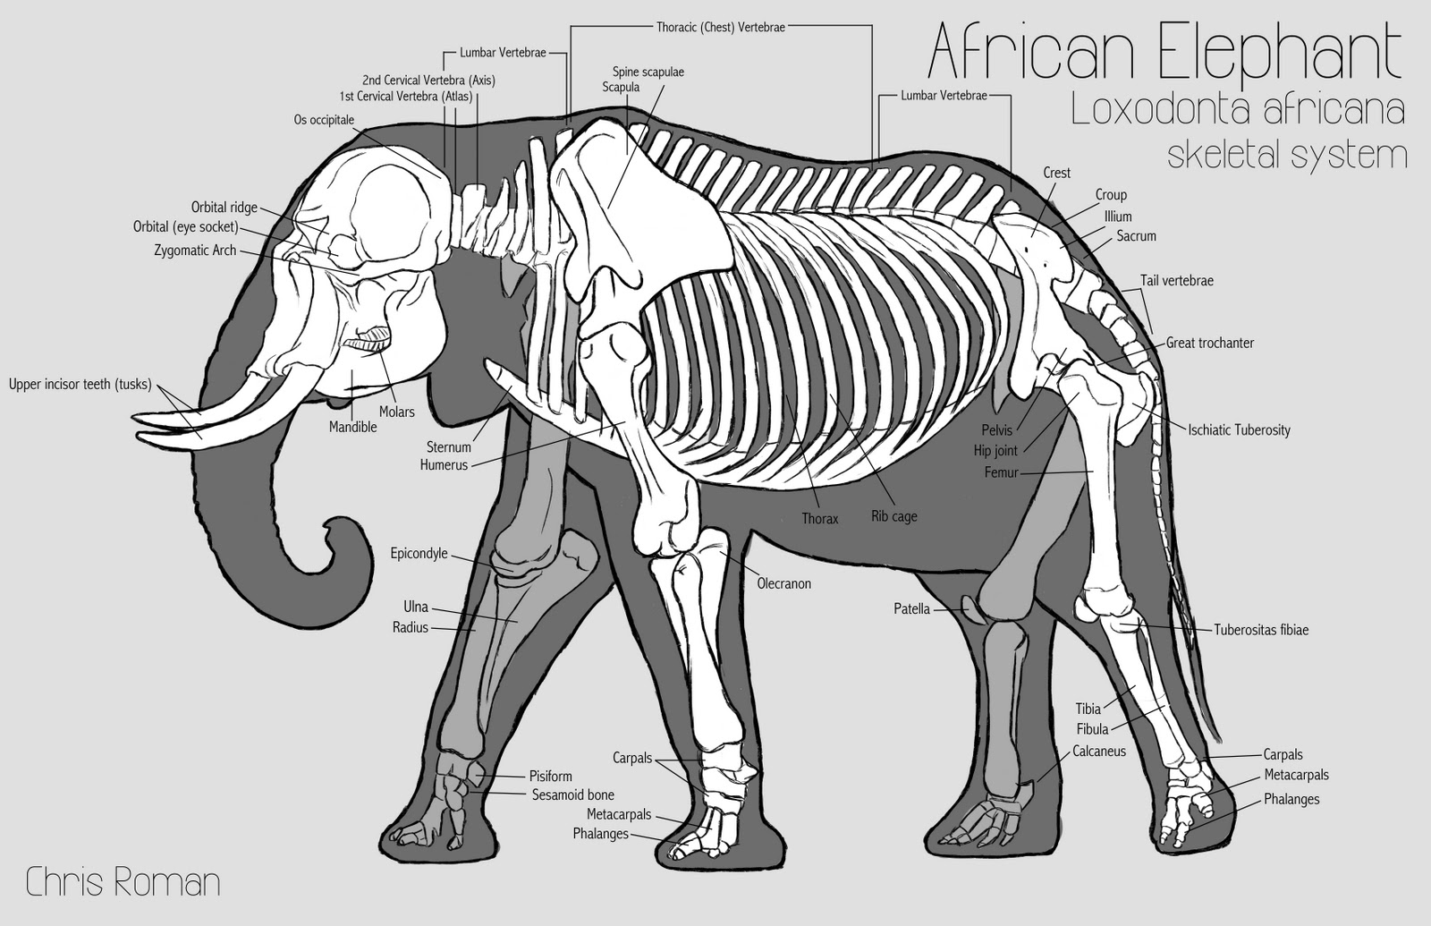

Slide 7
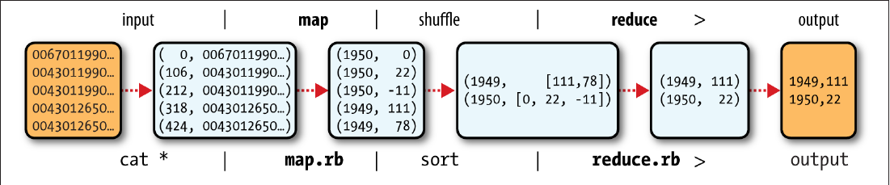

Slide 8
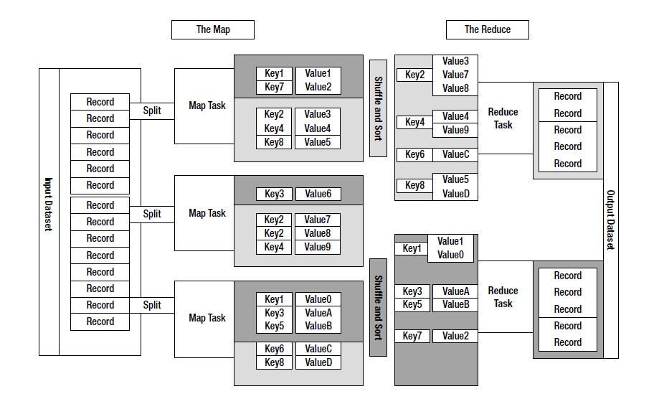

Slide 9
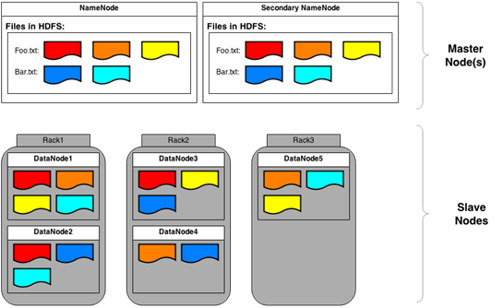
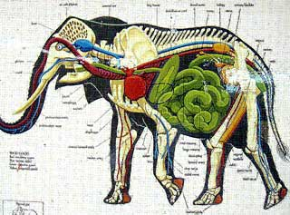

Slide 10
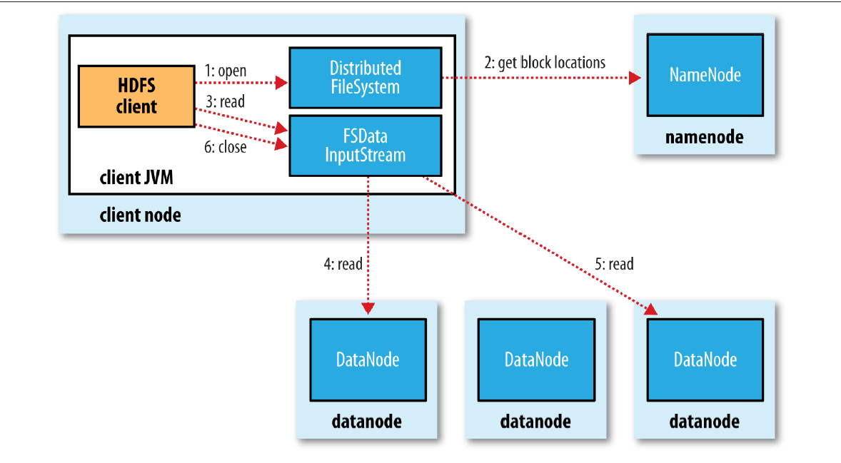

Slide 11
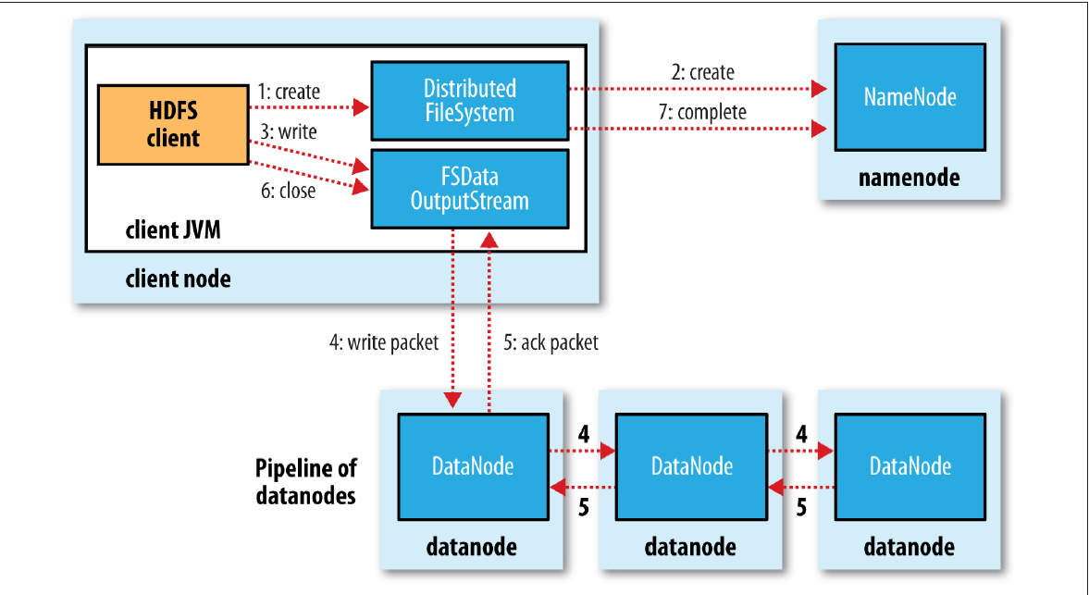

Slide 13
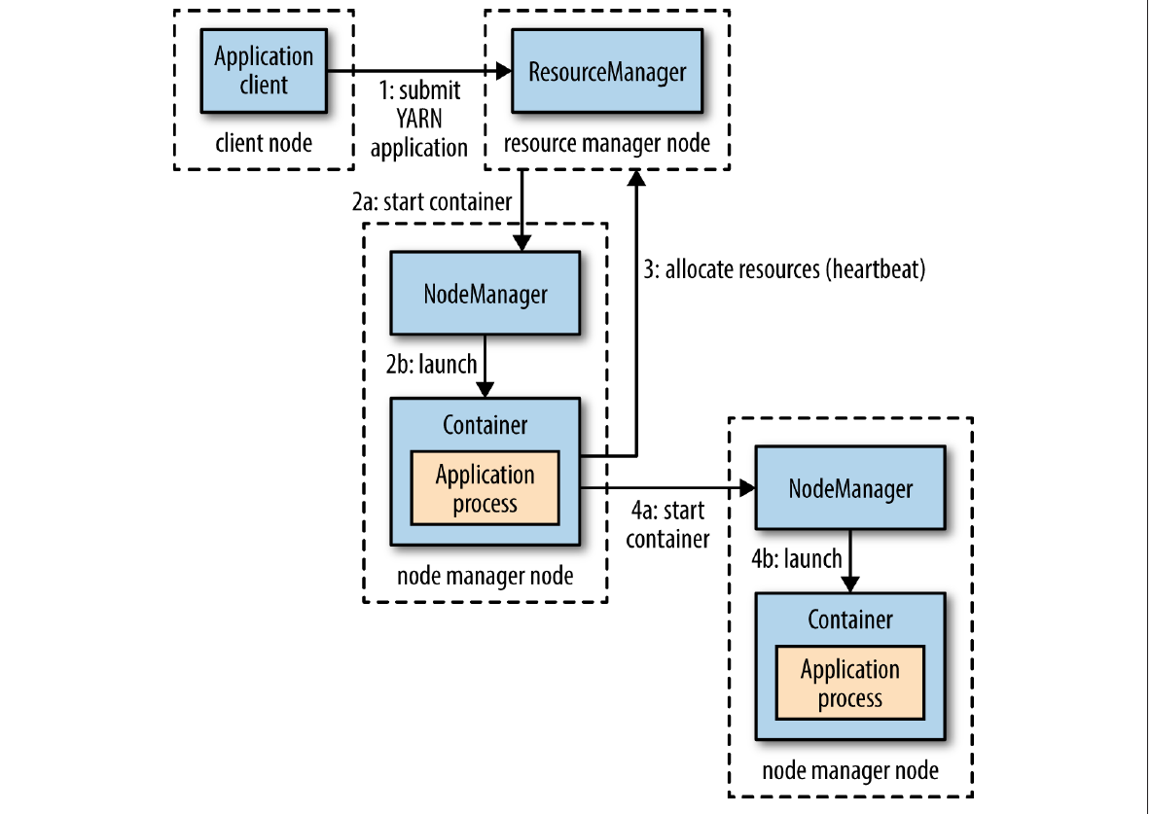
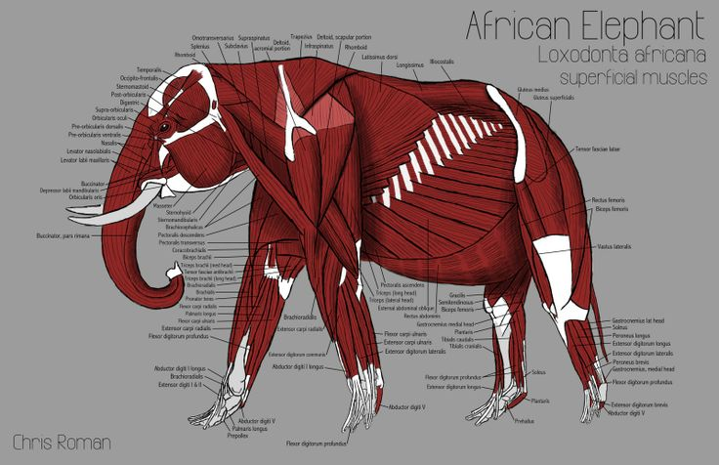

Slide 14
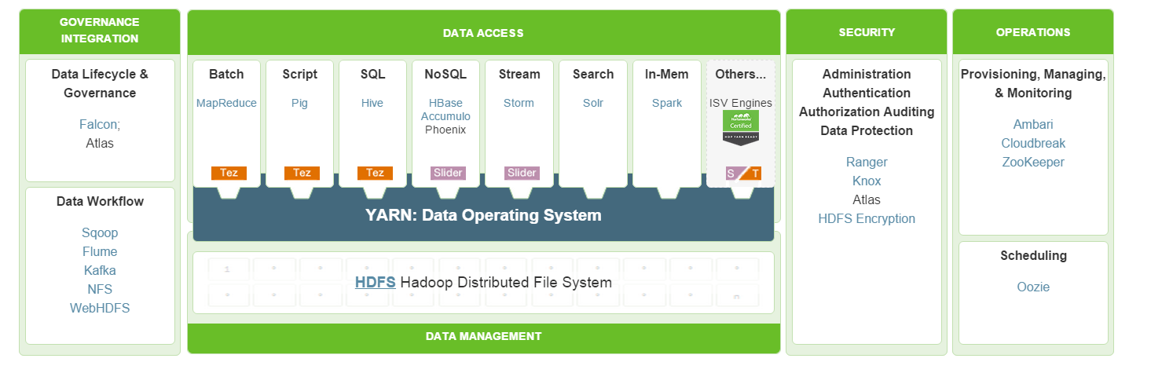
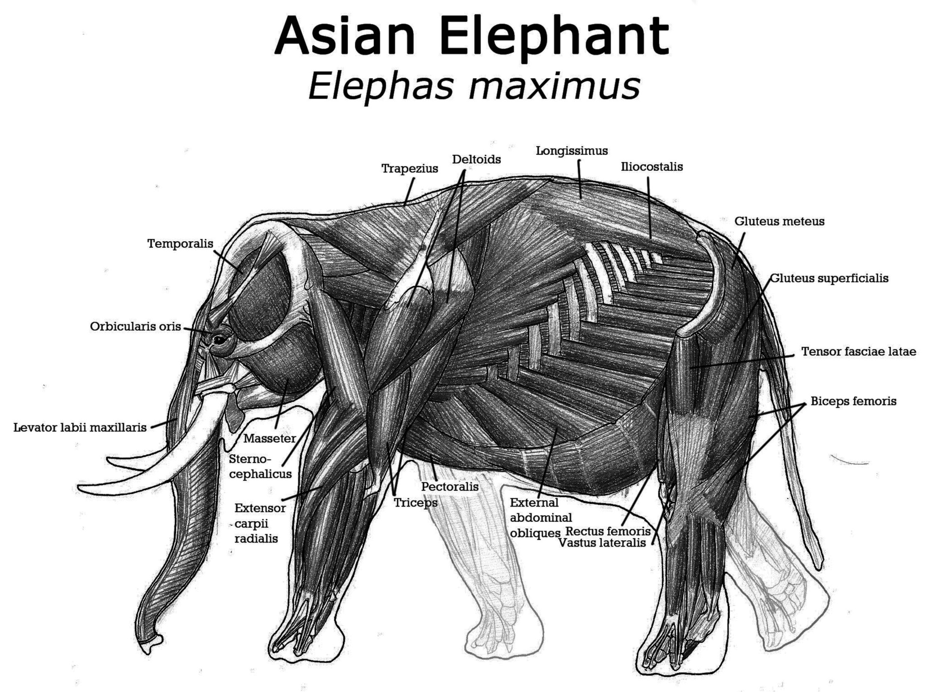

Slide 15


Slide 16


Slide 17
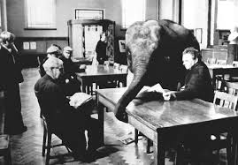

Slide 18

What’s next?
Get HDP Sandbox from http://hortonworks.com/hdp/downloads/
Install and run
Try to run sample cases from http://hortonworks.com/use-cases/
Read the book

Slide 19

Thank you!

